Slide 1
Deep Learning from Scratch
Theory + Practical
FAHAD HUSSAIN
MCS, MSCS, DAE(CIT)
Computer Science Instructor of well known international Center
Also, Machine Learning and Deep learning Practitioner
For further assistance, code and slide https://fahadhussaincs.blogspot.com/
YouTube Channel : https://www.youtube.com/fahadhussaintutorial

Slide 2
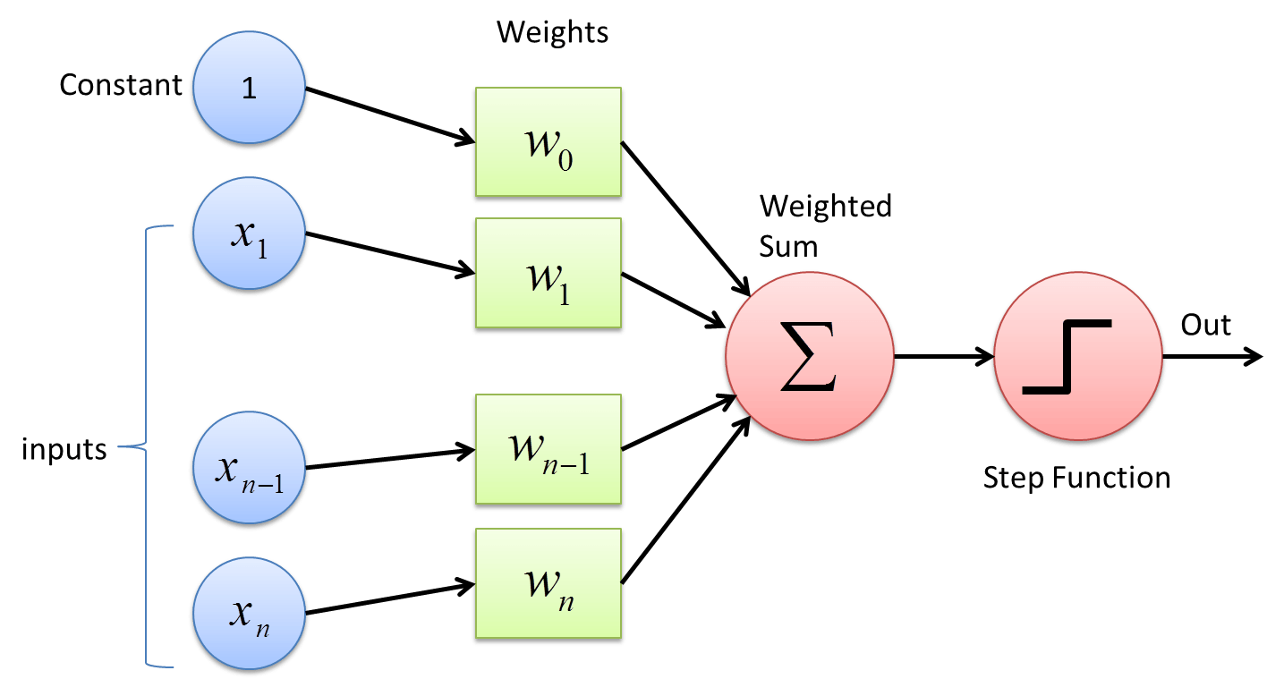
How Neural Network Work and Back Propagation in deep learning
For further assistance, code and slide https://fahadhussaincs.blogspot.com/
YouTube Channel : https://www.youtube.com/fahadhussaintutorial

Slide 3
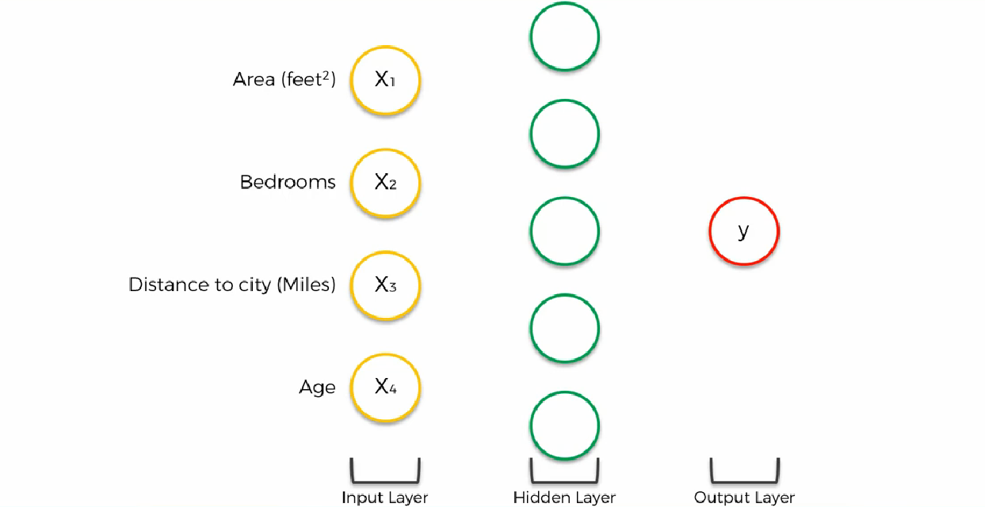
How Neural Network Work with many neurons
For further assistance, code and slide https://fahadhussaincs.blogspot.com/
YouTube Channel : https://www.youtube.com/fahadhussaintutorial

Slide 4
Back Propagation in deep learning
Back-propagation is the essence of neural net training. It is the method of fine-tuning the weights of a neural net based on the error rate obtained in the previous epoch (i.e., iteration). Proper tuning of the weights allows you to reduce error rates and to make the model reliable by increasing its generalization.
Backpropagation is a short form for "backward propagation of errors." It is a standard method of training artificial neural networks. This method helps to calculate the gradient of a loss function with respects to all the weights in the network.
For further assistance, code and slide https://fahadhussaincs.blogspot.com/
YouTube Channel : https://www.youtube.com/fahadhussaintutorial

Slide 5
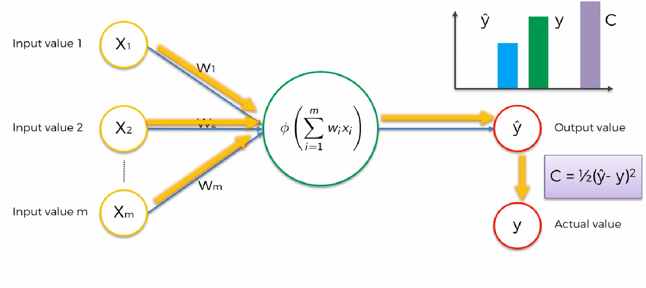
Back Propagation in deep learning
For further assistance, code and slide https://fahadhussaincs.blogspot.com/
YouTube Channel : https://www.youtube.com/fahadhussaintutorial

Slide 6
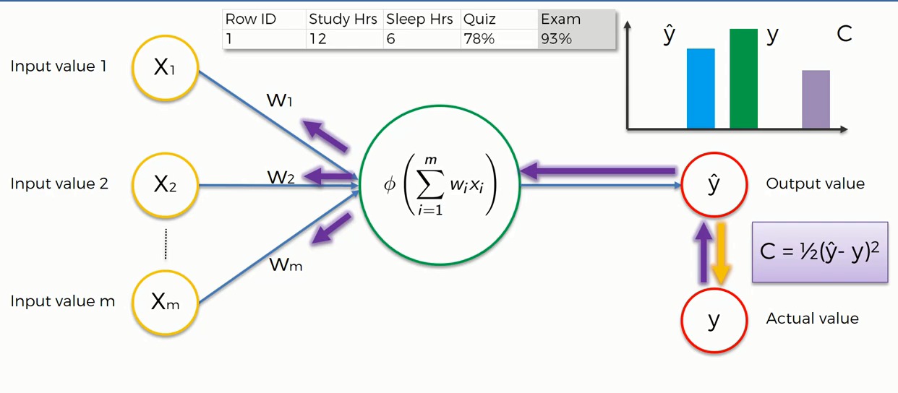
Back Propagation in deep learning
For further assistance, code and slide https://fahadhussaincs.blogspot.com/
YouTube Channel : https://www.youtube.com/fahadhussaintutorial

Slide 7
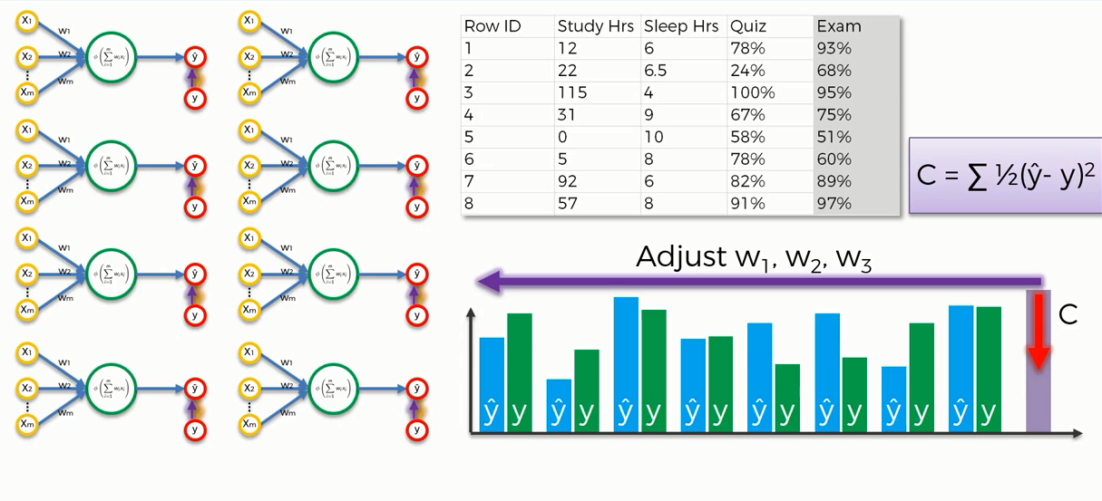
Back Propagation in deep learning (epoch)
For further assistance, code and slide https://fahadhussaincs.blogspot.com/
YouTube Channel : https://www.youtube.com/fahadhussaintutorial

Slide 8
For further assistance Visit Stack Exchange
https://stats.stackexchange.com/questions/154879/a-list-of-cost-functions-used-in-neural-networks-alongside-applications
For further assistance, code and slide https://fahadhussaincs.blogspot.com/
YouTube Channel : https://www.youtube.com/fahadhussaintutorial

Slide 9
Thank You!
For further assistance, code and slide https://fahadhussaincs.blogspot.com/
YouTube Channel : https://www.youtube.com/fahadhussaintutorial

